Slide 1
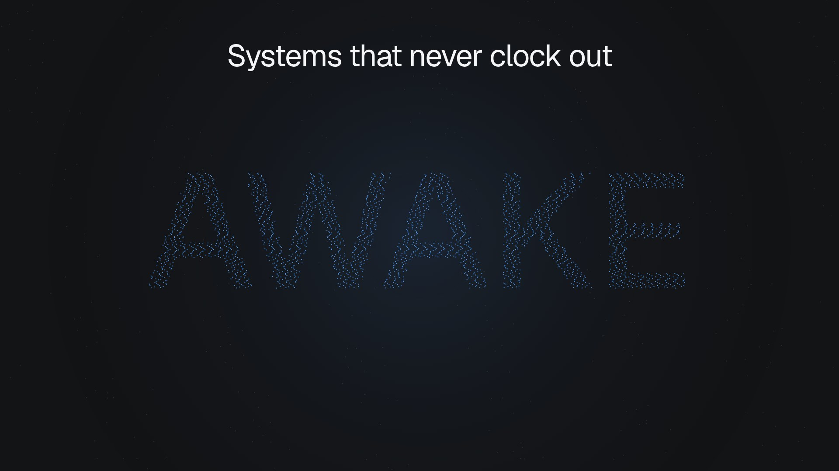
Notes:
Always Awake
While you sleep, his systems are awake. Daniel Shammah builds autonomous AI that runs around the clock, in production, on its own.

Slide 2
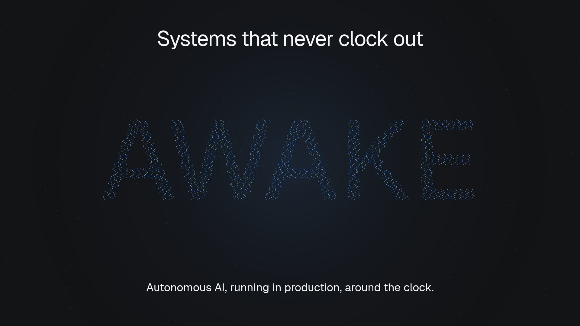
Notes:
Always Awake (continued, beat 2 of 2)

Slide 3
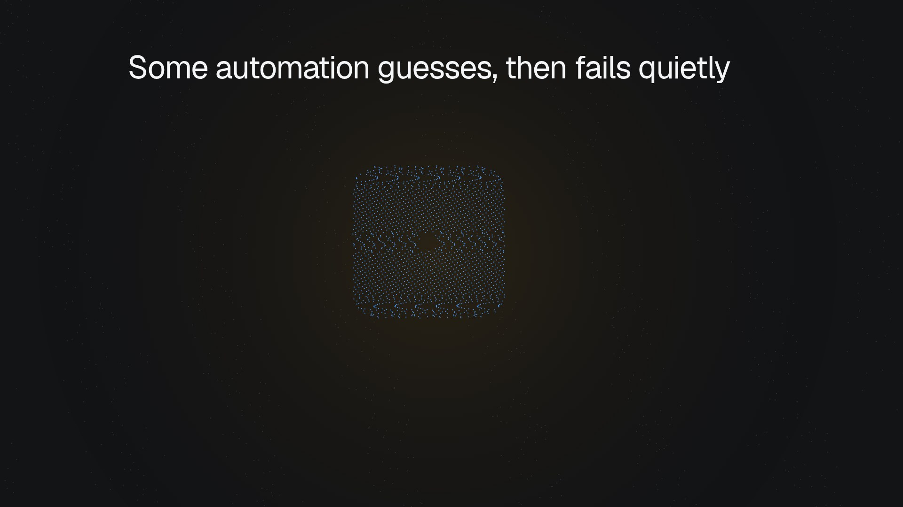
Notes:
The Guess
Some automation guesses. When it is wrong, it fills the gap with invented values and fails without a sound.

Slide 4
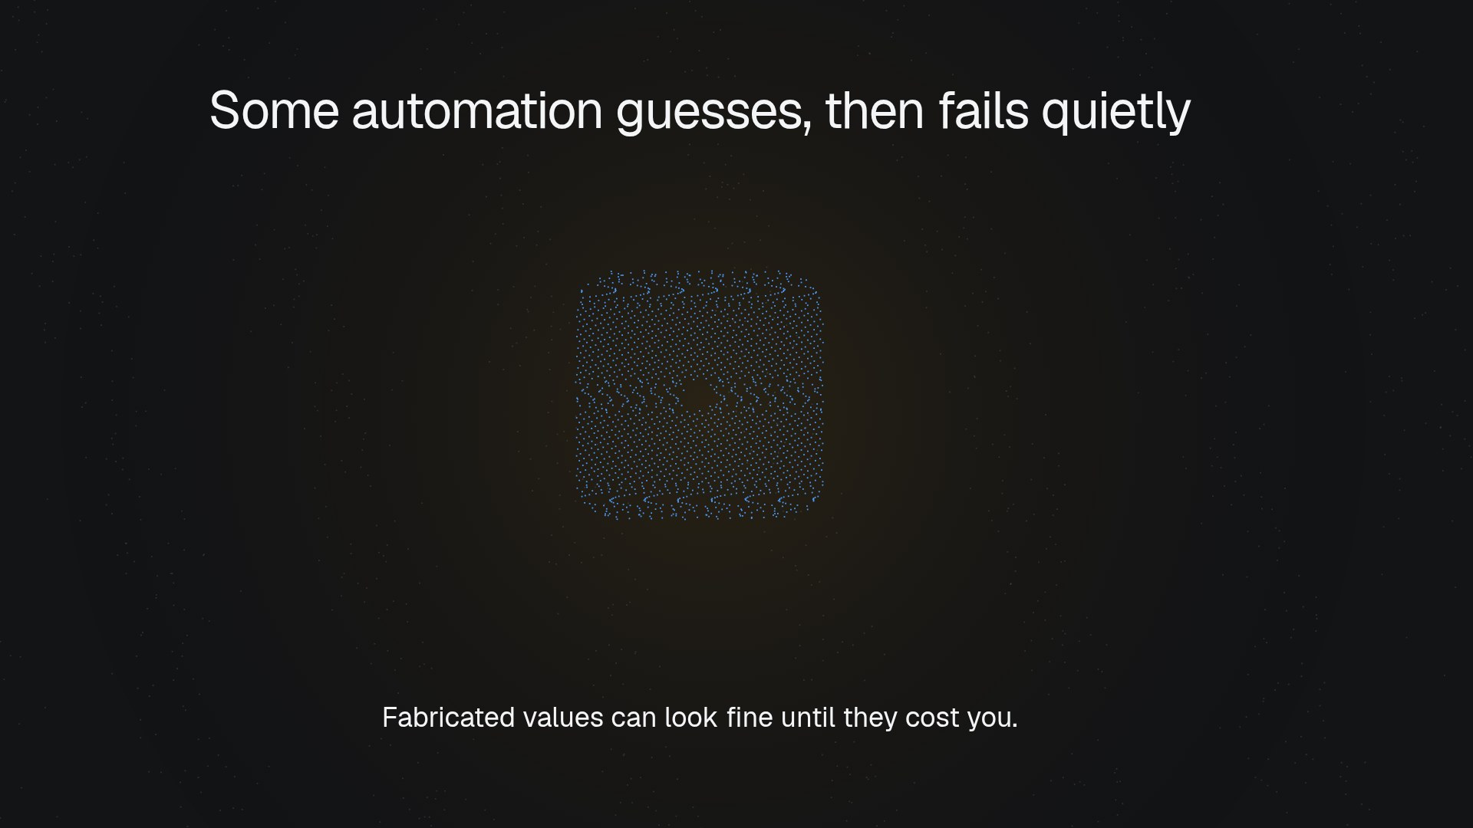
Notes:
The Guess (continued, beat 2 of 2)

Slide 5
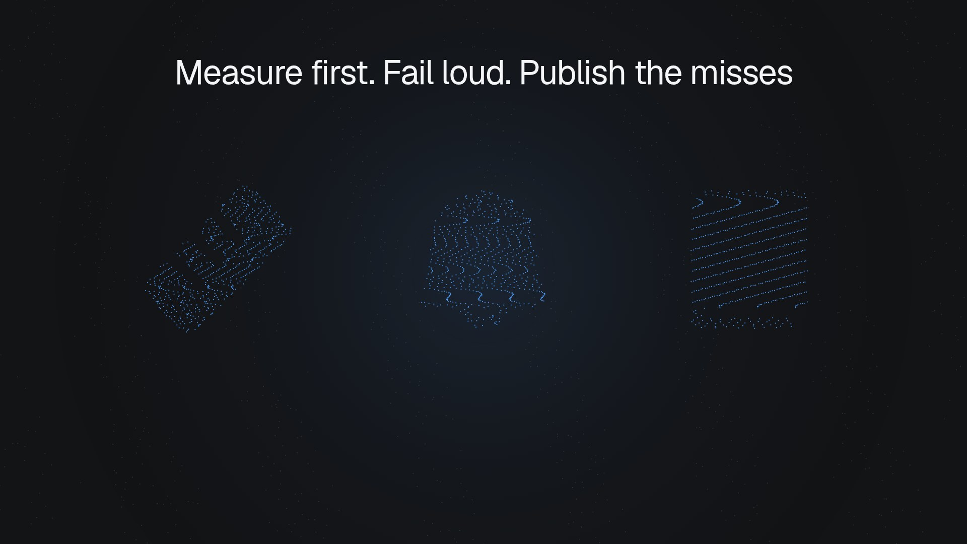
Notes:
The Method
His method is three rules. Measure first. Fail loud. Publish the negative results, not only the wins.

Slide 6
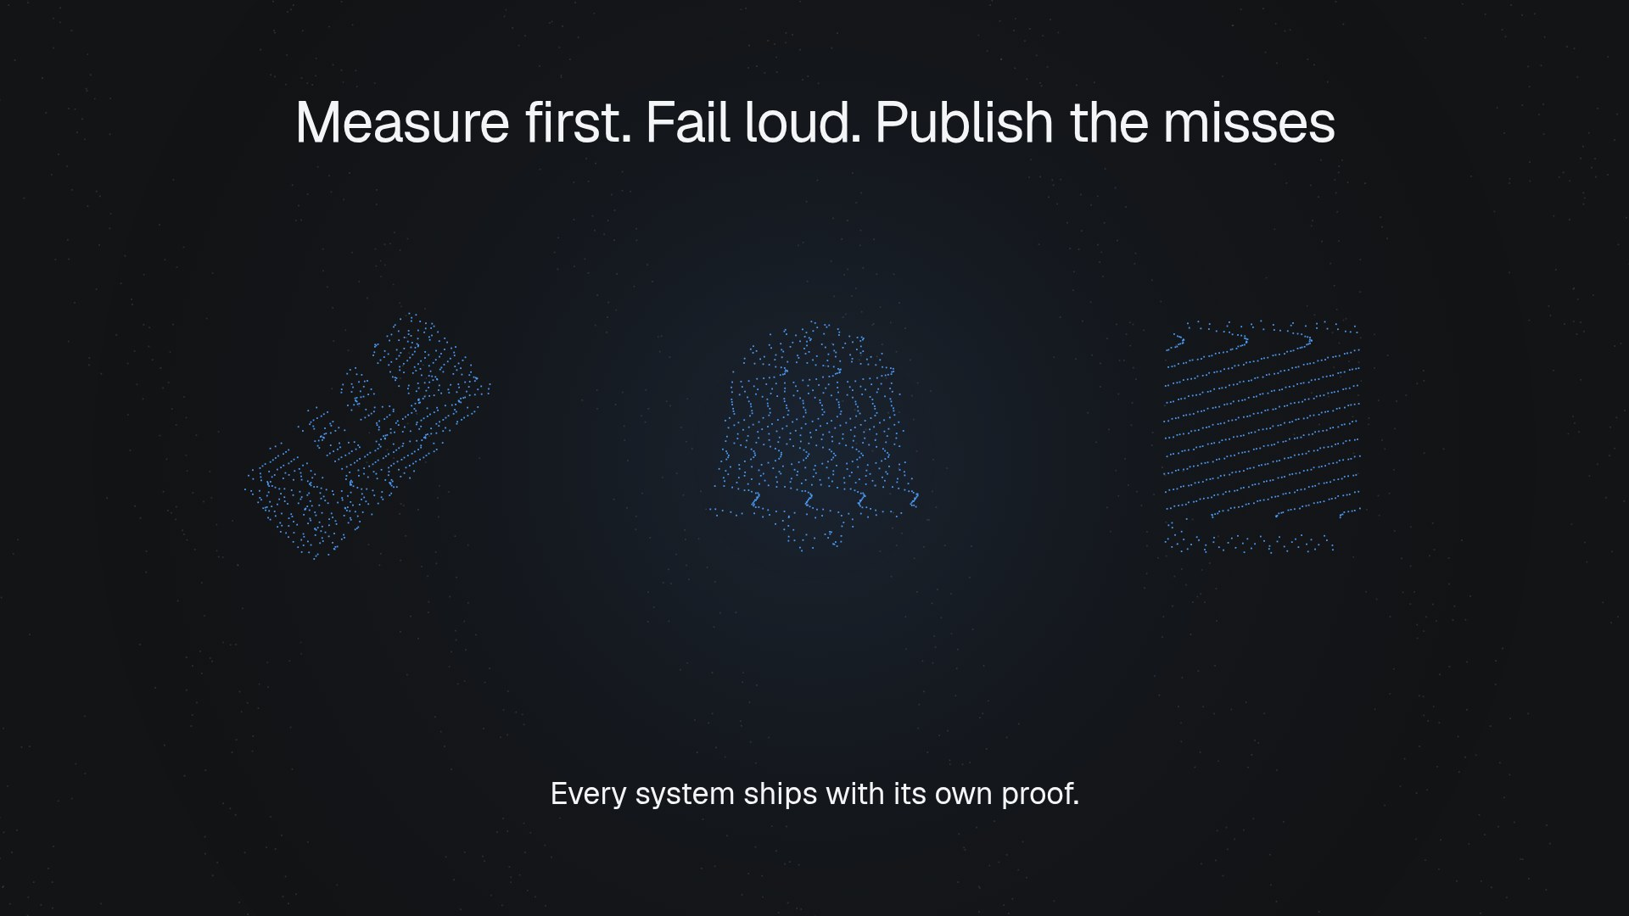
Notes:
The Method (continued, beat 2 of 2)

Slide 7
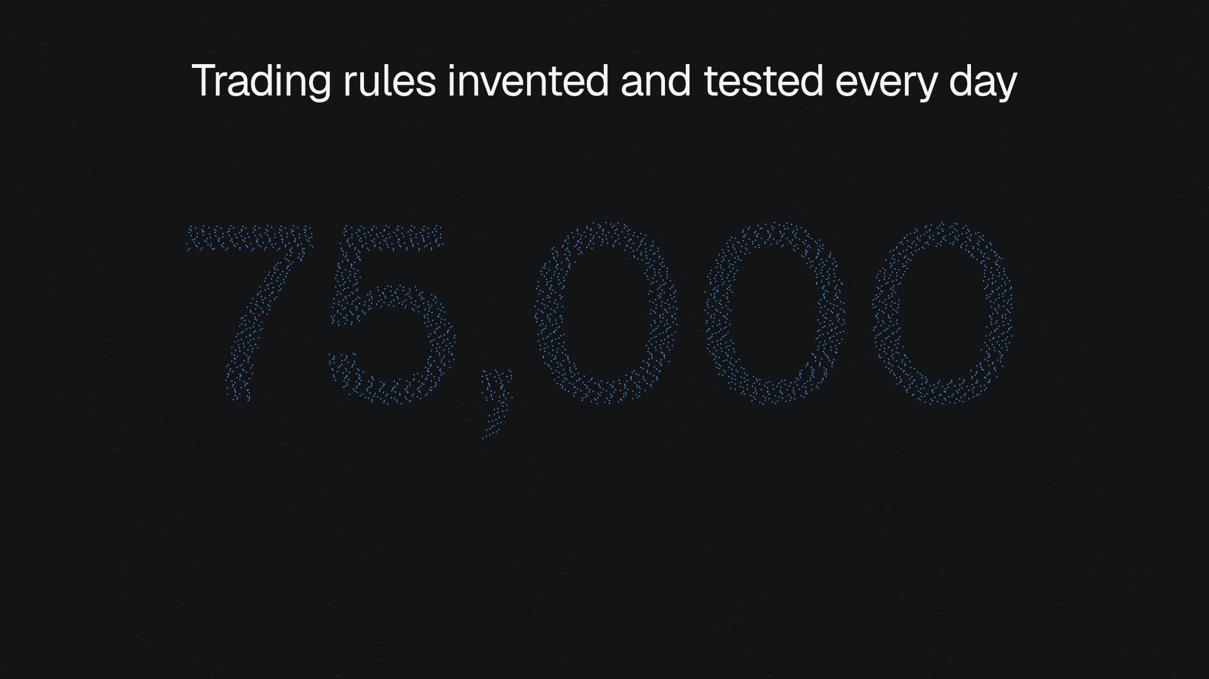
Notes:
The Council
In his trading research platform, a council of AI agents debates every market decision. Its research engine invents and tests new trading rules every fifteen minutes, all day.

Slide 8
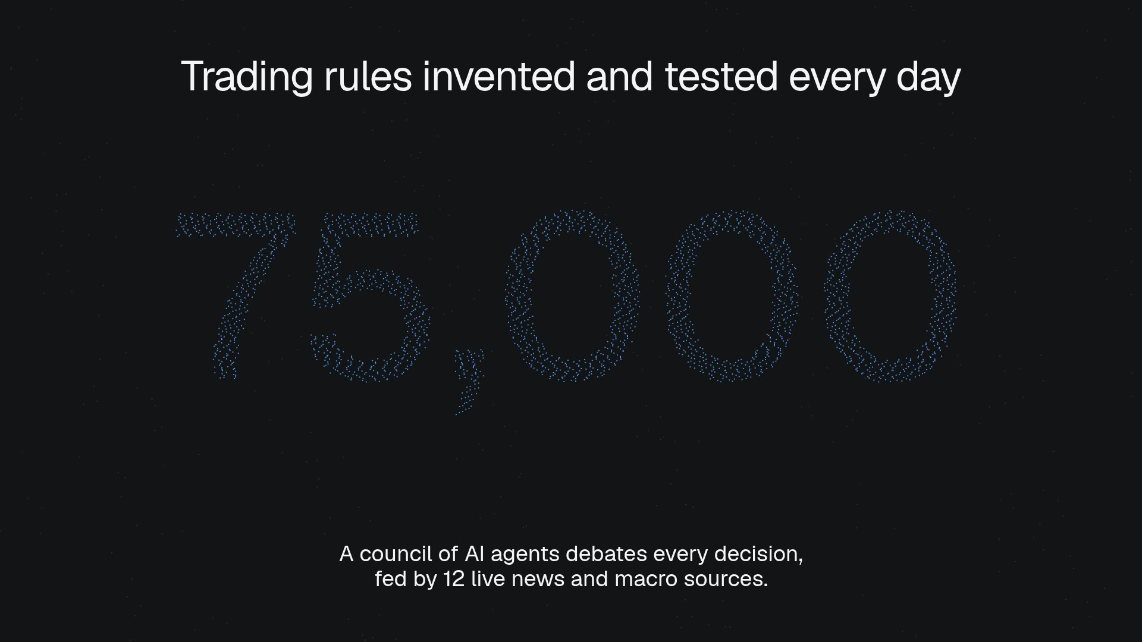
Notes:
The Council (continued, beat 2 of 2)

Slide 9
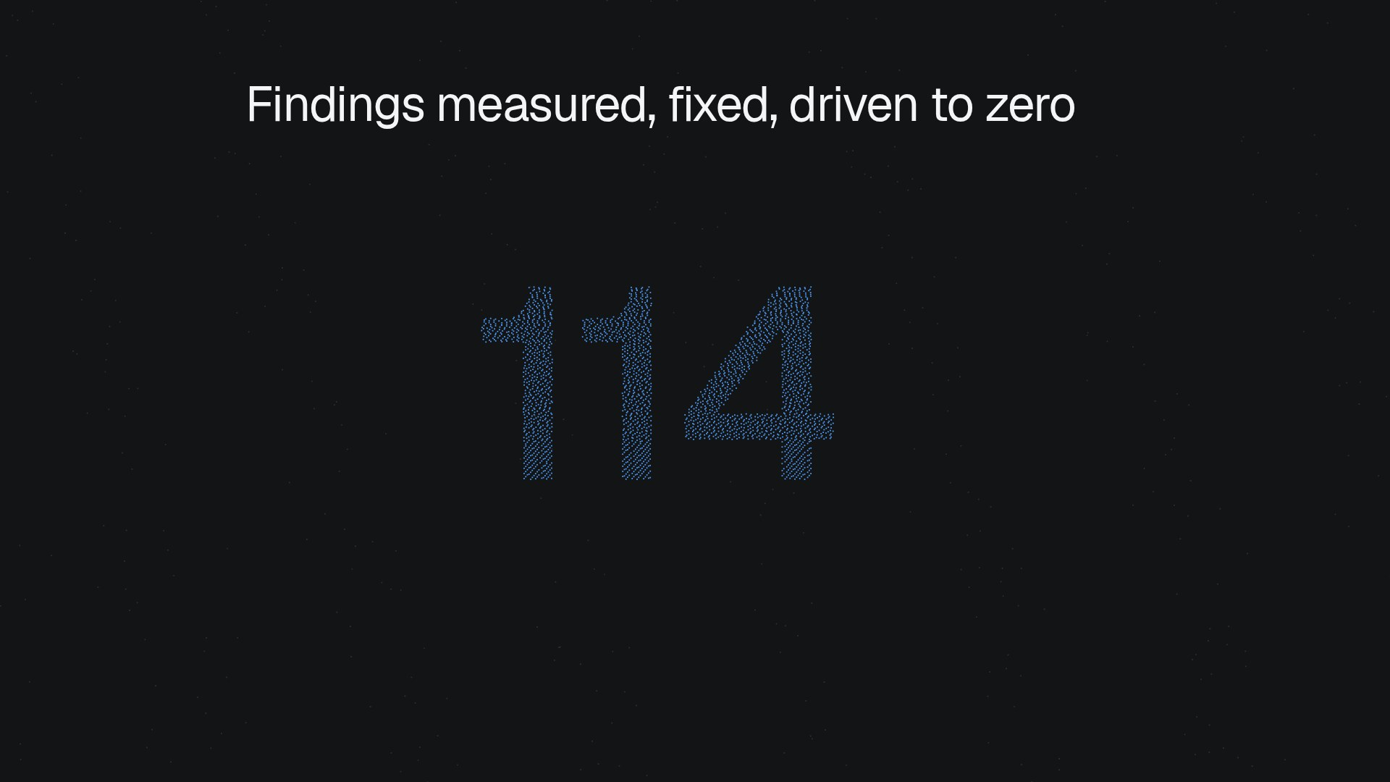
Notes:
It Measures
UXAI is his AI design engineer. It captures real pages in a browser, measures accessibility and layout, then fixes the code, and on its own site it drove every finding to zero.

Slide 10
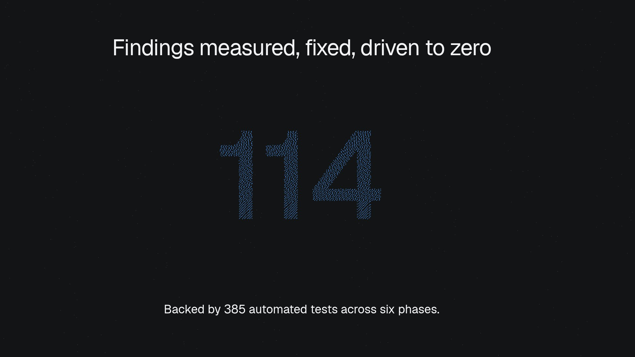
Notes:
It Measures (continued, beat 2 of 2)

Slide 11
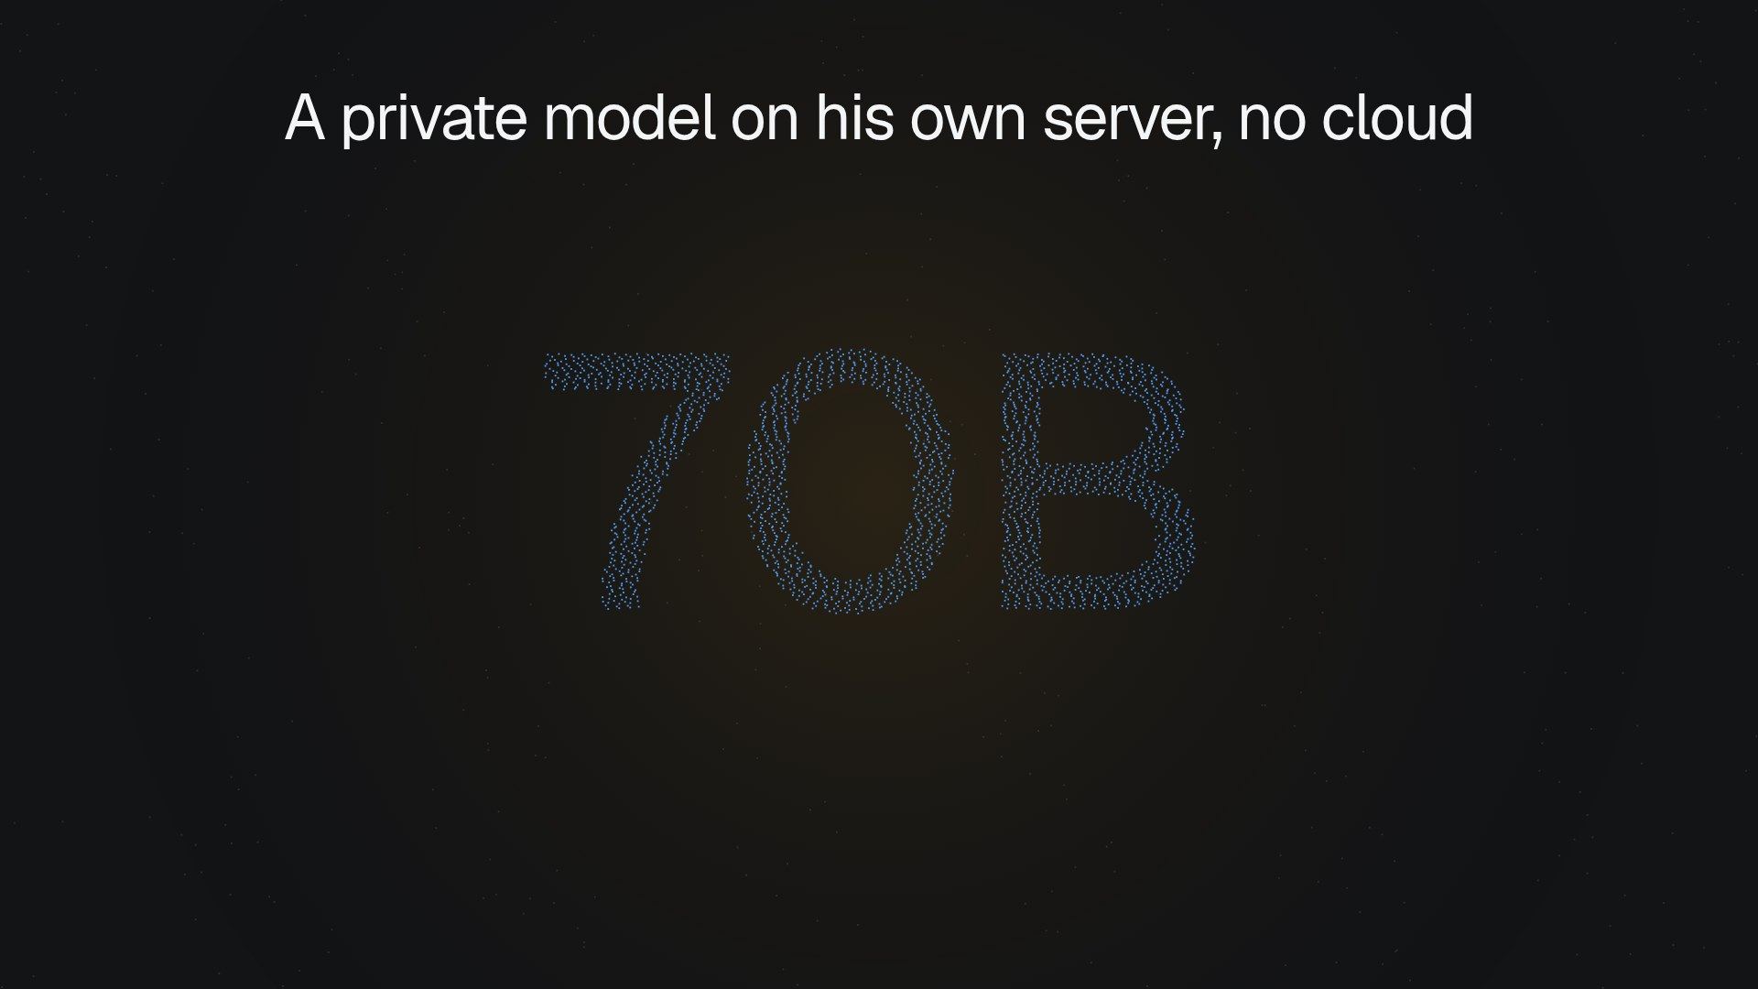
Notes:
Private Brain
JARVIS is his private assistant. A large language model runs on his own server, with no cloud.

Slide 12
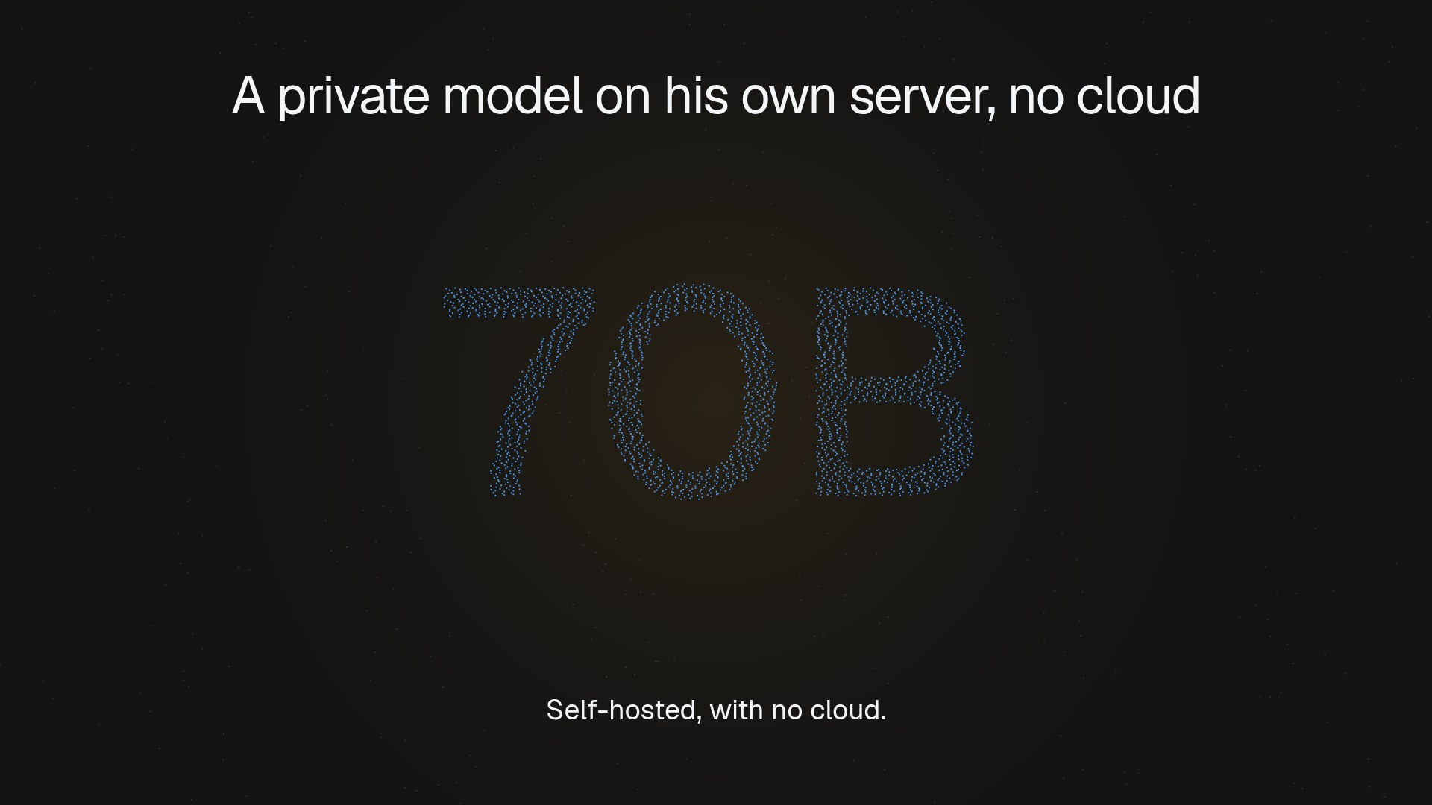
Notes:
Private Brain (continued, beat 2 of 2)

Slide 13
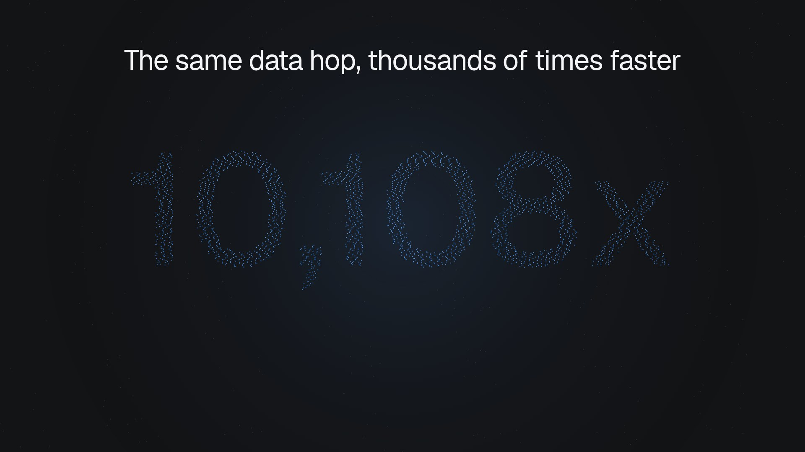
Notes:
The Core
Underneath it all is THE CORE, his Rust engine of fail-loud building blocks. It made one data hop dramatically faster.

Slide 14
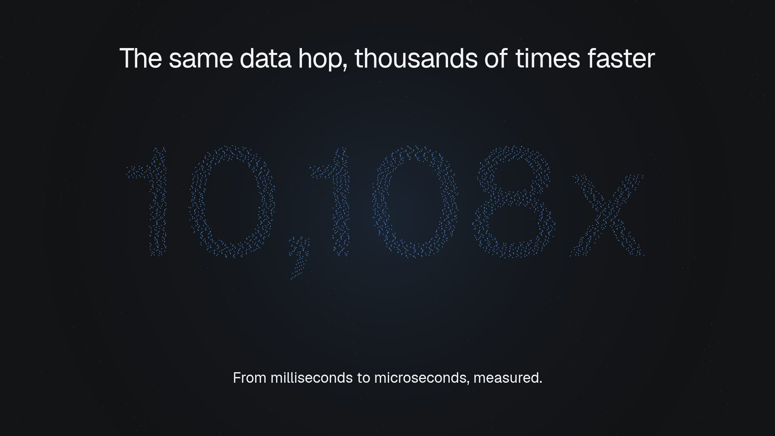
Notes:
The Core (continued, beat 2 of 3)

Slide 15
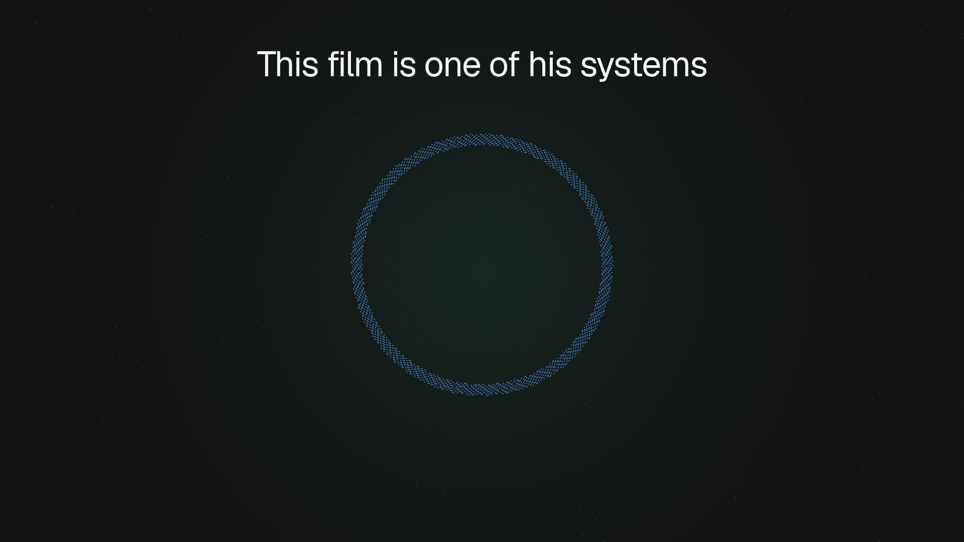
Notes:
This Film
And this film? UXAI Deck, another system he built, turned a short brief into what you are watching. Alongside it, he ships production websites for real businesses.

Slide 16
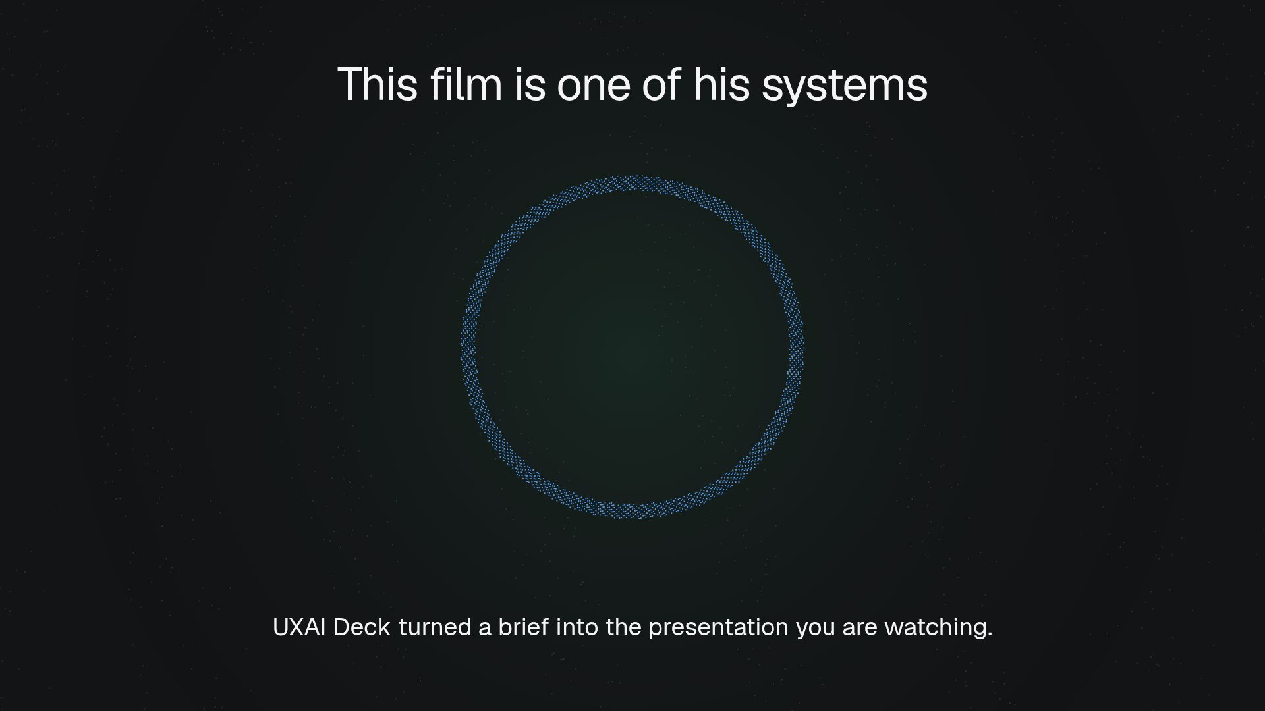
Notes:
This Film (continued, beat 2 of 2)

Slide 17

Notes:
Hire Him
Systems that measure, fail loud and prove themselves. Hire Daniel Shammah at danielshammah dot com.

Slide 18
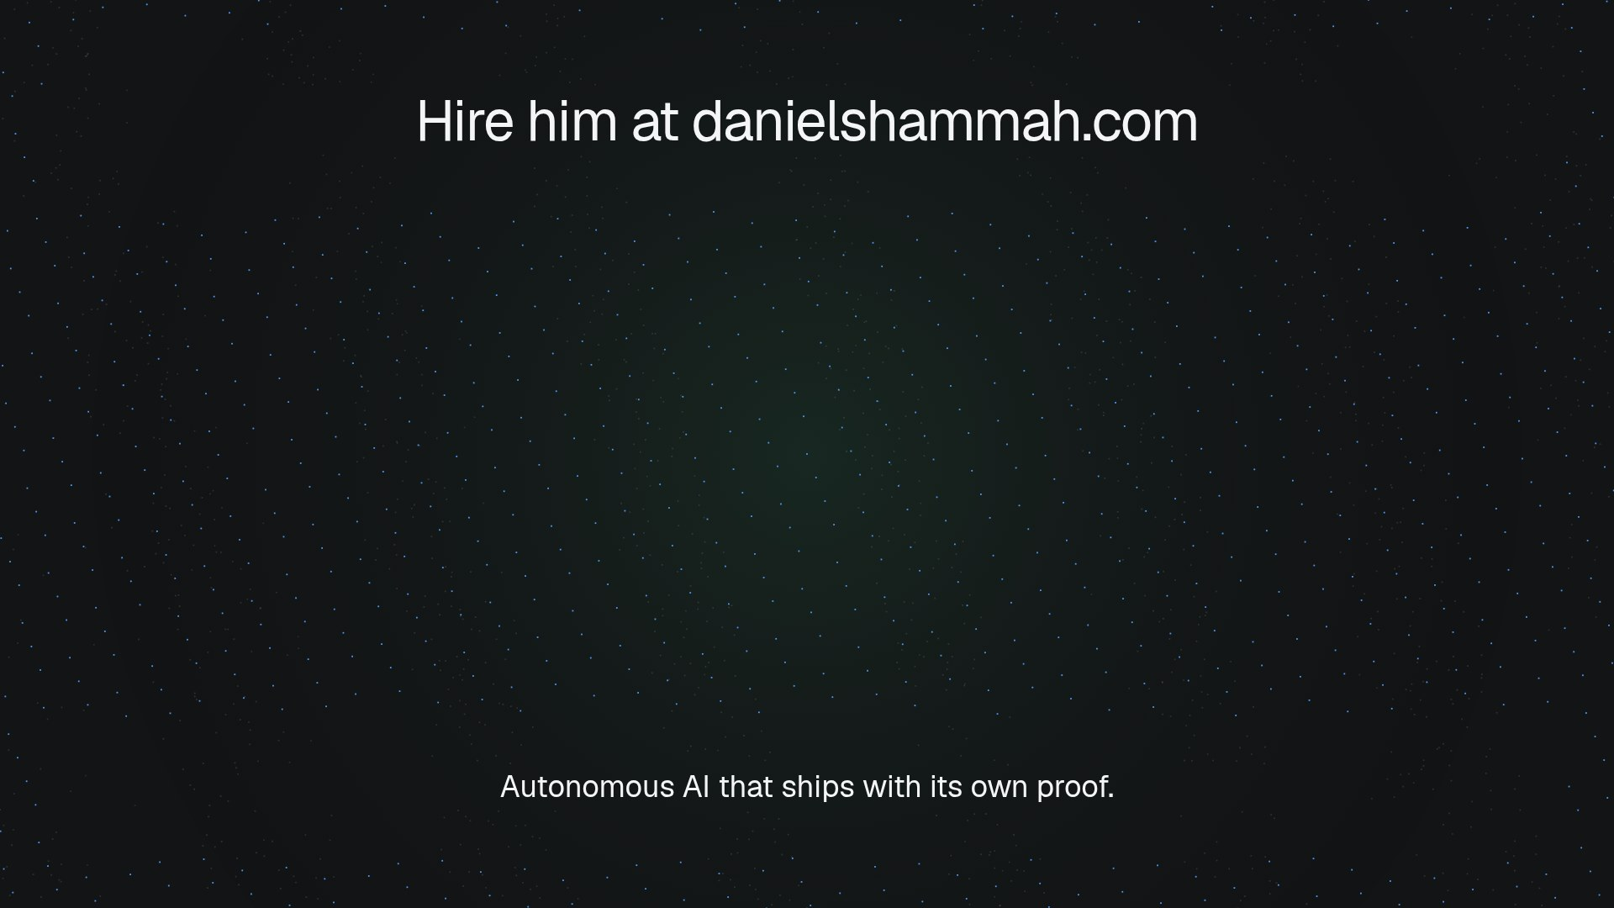
Notes:
Hire Him (continued, beat 2 of 2)

Slide 19
Every number, and where it came from
10,108x faster data hop, 74 ms to 7.3 microseconds, with THE CORE: THE CORE core-lane production benchmark, 2026-08
114 accessibility and layout findings fixed to zero by UXAI on its own site: UXAI deployment audit, 2026-08
385 automated tests behind UXAI's six phases: UXAI repository test suite
75,000 trading rules generated and tested per day by the AI research engine: AI research engine loop, 2026-09
70B parameter language model running privately on his own server: JARVIS deep brain, 2026-10
12 live news and macro data APIs feeding the AI agents: Oracle entity, 2026-08

